Slide 1
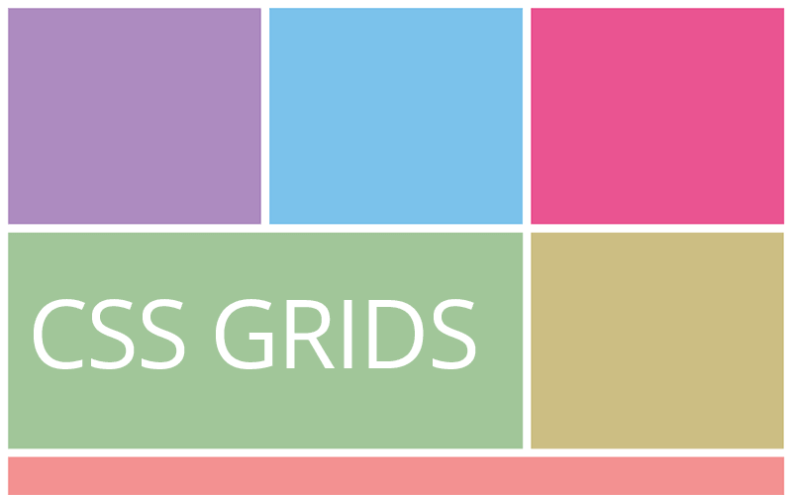
Grid
The Most Powerful Grid System
SoftUni Team
Technical Trainers
Software University
https://softuni.org

Slide 2
Table of Contents
Grid Layout
Grid Properties
Properties for the Parent (Grid Container)
Properties for the Children (Grid Items)
2
Notes:
2

Slide 3
Have a Question?
sli.do
#front-end
Notes:
3

Slide 4
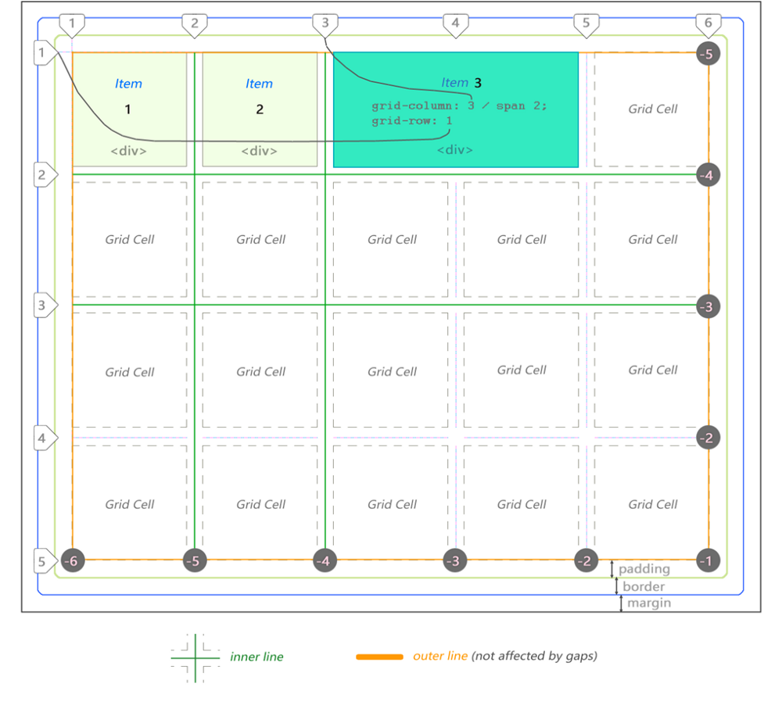
Grid
2-dimensional layout system
Notes:
4

Slide 5
CSS Grid Layout
Excels at dividing a page into major regions or defining the relationship in terms of size, position, and layer
Grid layout enables an author to align elements into columns and rows
5

Slide 6
CSS Grid Layout
Excels at dividing a page into major regions or defining the relationship in terms of size, position, and layer
Grid layout enables an author to align elements into columns and rows
6

Slide 7
7

Slide 8
Grid Properties
Properties for the Parent (Grid Container)

Slide 9
Display
Defines the element as a grid container and establishes a new grid formatting context for its contents
Values
grid - generates a block-level grid
inline-grid - generates an inline-level grid
.container {
display: grid | inline-grid;
}

Slide 10
Grid Column
A vertical track in a CSS Grid Layout, and is the space between two vertical grid lines
It is defined by the grid-template-columns property
.grid-container {
display: grid;
grid-template-columns: auto auto auto auto;
}
10

Slide 11
Grid Row
A grid row is a horizontal track in a CSS Grid Layout, that is the space between two horizontal grid lines
It is defined by the grid-template-rows property
.grid-container {
display: grid;
grid-template-rows: 25% 100px auto;
}
11

Slide 12
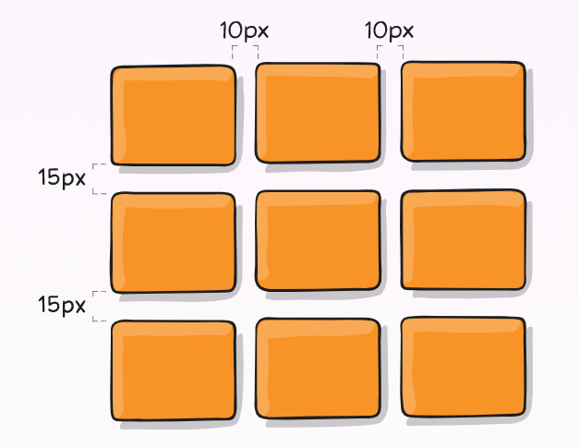
Gutters (Gaps)
Gutters or alleys are spacing between rows and columns
These can be created using the grid-column-gap, grid-row-gap, or grid-gap properties
.container {
grid-template-columns: 100px 50px 100px;
grid-template-rows: 80px auto 80px;
column-gap: 10px;
row-gap: 15px;
}
12

Slide 13
Grid Units
The fr unit allows you to set the size of a track as a fraction of the free space of the grid container
For example, this will set each item to one third the width of the grid container:
The free space is calculated after any non-flexible items
.container {
grid-template-columns: 1fr 1fr 1fr;
}

Slide 14
Grid Template Areas
Defines a grid template by referencing the names of the grid areas which are specified with the grid-area property
Repeating the name of a grid area causes the content to span those cells
A period signifies an empty cell
The syntax itself provides a visualization of the structure of the grid

Slide 15
Grid Template Areas
Values:
<grid-area-name> - the name of a grid area specified with grid-area
. - a period signifies an empty grid cell
none - no grid areas are defined

Slide 16
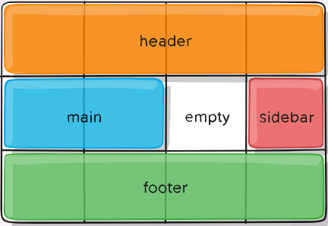
Grid Template Areas - Example
.item-a {
grid-area: header;
}
.item-b {
grid-area: main;
}
.item-c {
grid-area: sidebar;
}
.item-d {
grid-area: footer;
}
.container {
display: grid;
grid-template-columns: 50px 50px 50px 50px;
grid-template-rows: auto;
grid-template-areas:
'header header header header'
'main main . sidebar'
'footer footer footer footer';
}

Slide 17
Justify Items
Aligns grid items along the inline (row) axis
This value applies to all grid items inside the container
Values:
start - aligns items to be flush with the start edge of their cell
end - aligns items to be flush with the end edge of their cell
center - aligns items in the center of their cell
stretch - fills the whole width of the cell (this is the default)
justify-items: start | end | center | stretch;

Slide 18
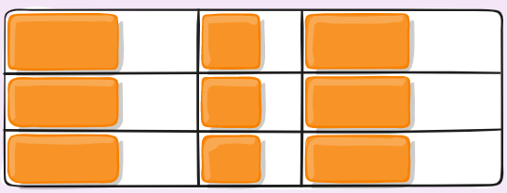
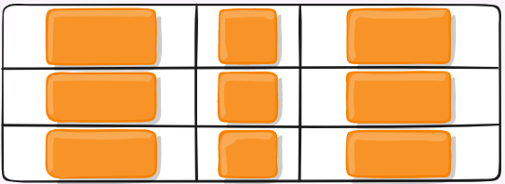
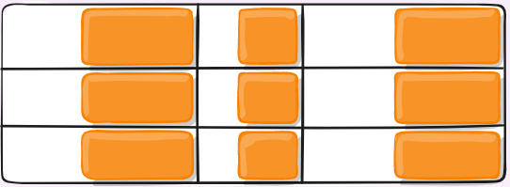
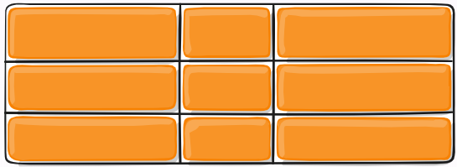
Justify Items - Example
justify-items: start;
justify-items: center;
justify-items: end;
justify-items: stretch;

Slide 19
Align Items
Aligns grid items along the block (column) axis (as opposed to justify-items which aligns along the inline (row) axis)
This value applies to all grid items inside the container
Values:
start - aligns items to be flush with the start edge of their cell
end - aligns items to be flush with the end edge of their cell
center - aligns items in the center of their cell
stretch - fills the whole height of the cell (this is the default)
align-items: start | end | center | stretch;

Slide 20
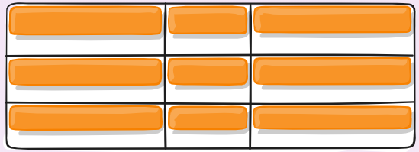
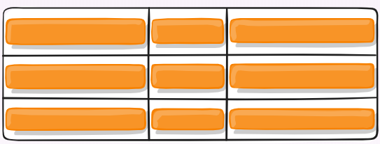
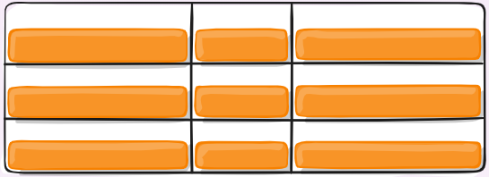
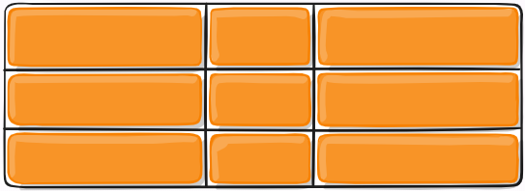
Align Items - Example
align-items: start;
align-items: center;
align-items: end;
align-items: stretch;

Slide 21
Justify Content
Sometimes the total size of your grid might be less than the size of its grid container
This could happen if all of your grid items are sized with non-flexible units like px
In this case you can set the alignment of the grid within the grid container
Values:
justify-content: start | end | center | stretch | space-around | space-between | space-evenly;

Slide 22
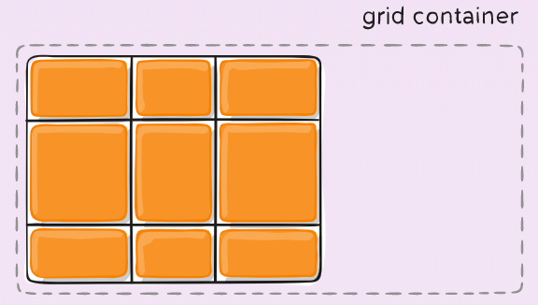
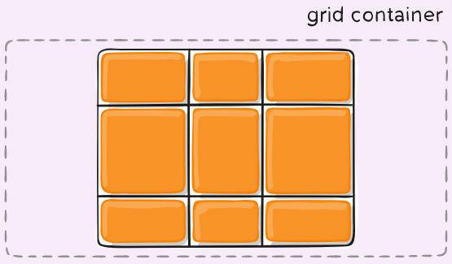
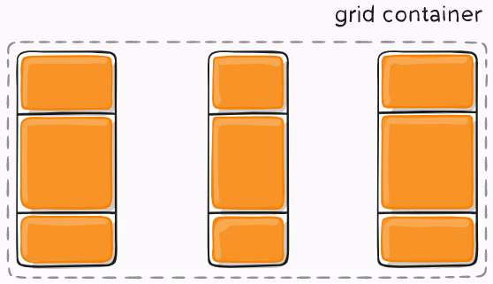
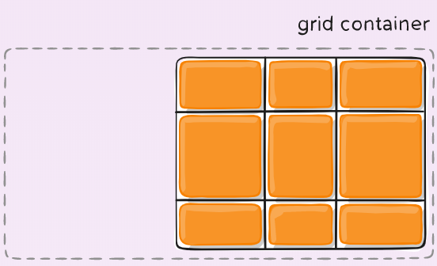
Justify Content - Example
justify-content: start;
justify-content: center;
justify-content: space-between;
justify-content: end;

Slide 23
Align Content
This property aligns the grid along the block (column) axis (as opposed to justify-content which aligns the grid along the inline (row) axis)
.container {
align-content: start | end | center | stretch | space-around | space-between | space-evenly;
}

Slide 24
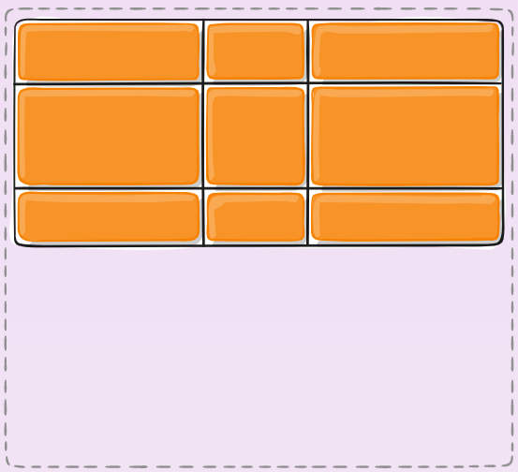
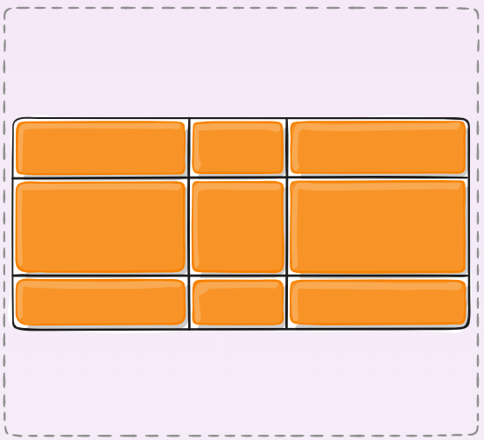
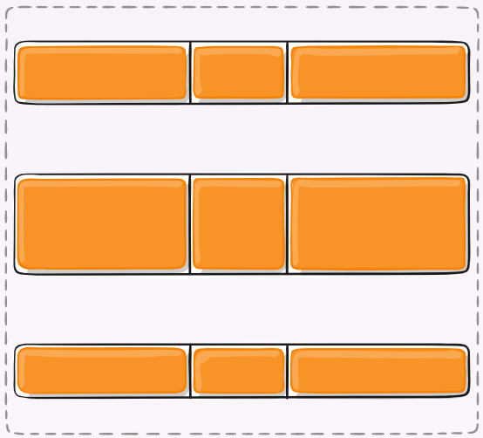
Align Content - Example
align-content: start;
align-content: center;
align-content: space-around;

Slide 25
Grid Auto Flow
If you have grid items that you don’t explicitly place on the grid, the auto-placement algorithm kicks in to automatically place the items
This property controls how the auto-placement algorithm works
.container {
grid-auto-flow: row | column | row dense | column dense;
}

Slide 26
Grid Properties
Properties for the Children (Grid Items)

Slide 27
Placing Grid Items
Determines a grid item's location within the grid by referring to specific grid lines
grid-column-start/grid-row-start is the line where the item begins
grid-column-end/grid-row-end is the line where the item ends
grid-column-start: <number> | <name> | span <number> | span <name> | auto
grid-column-end: <number> | <name> | span <number> | span <name> | auto
grid-row-start: <number> | <name> | span <number> | span <name> | auto
grid-row-end: <number> | <name> | span <number> | span <name> | auto

Slide 28
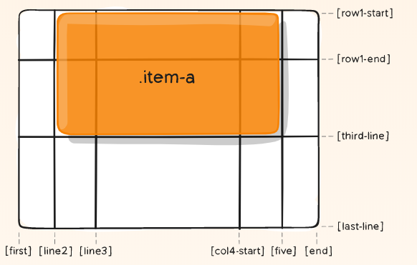
Placing Grid Items - Example
.item-a {
grid-column-start: 2;
grid-column-end: 5;
grid-row-start: 1;
grid-row-end: 3;
}

Slide 29
Grid Column, Grid Row
A shorthand property for grid-row-start and grid-row-end
Specifying a grid item’s size and location within the grid row by contributing a line, a span, or nothing (automatic) to its grid placement
Specifying the inline-start and inline-end edge of its grid area
grid-column: 3 / span 2;
grid-row: third-line / 4;

Slide 30
Justify Self
Aligns a grid item inside a cell along the inline (row) axis (as opposed to align-self which aligns along the block (column) axis)
This value applies to a grid item inside a single cell
.item {
justify-self: start | end | center | stretch;
}

Slide 31
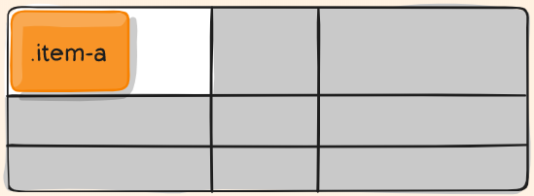
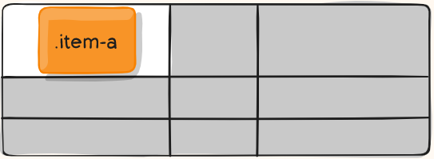
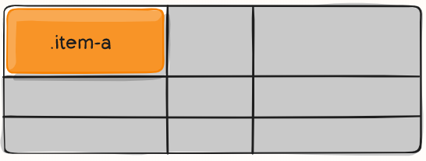
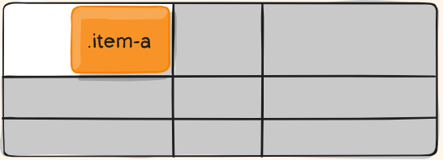
Justify Self - Example
justify-self: start;
justify-self: center;
justify-self: stretch;
justify-self: end;

Slide 32
Align Self
Aligns a grid item inside a cell along the block (column) axis (as opposed to justify-self which aligns along the inline (row) axis)
This value applies to the content inside a single grid item
.item {
align-self: start | end | center | stretch;
}

Slide 33
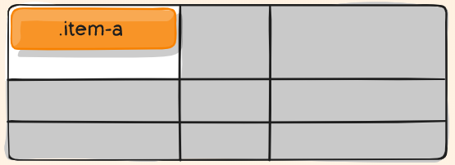
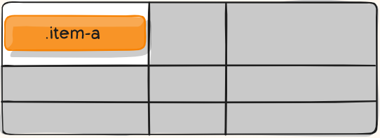
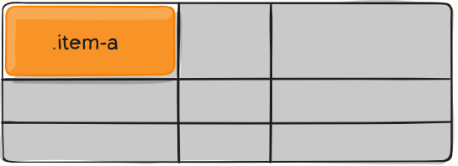
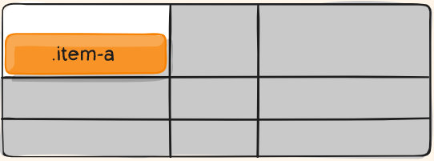
Align Self - Example
align-self: start;
align-self: center;
align-self: stretch;
align-self: end;

Slide 34

Summary
Grid Layout
Grid Properties
Properties for the Parent (Grid Container)
Properties for the Children (Grid Items)
Notes:
34

Slide 35
Questions?
Notes:
35

Slide 36














SoftUni Diamond Partners

Slide 37

License
This course (slides, examples, demos, exercises, homework, documents, videos and other assets) is copyrighted content
Unauthorized copy, reproduction or use is illegal
© SoftUni - https://softuni.org
© Software University - https://softuni.bg
Notes:
37

Slide 38
Trainings @ Software University (SoftUni)
Software University - High-Quality Education, Profession and Job for Software Developers
softuni.bg
Software University Foundation
softuni.foundation
Software University @ Facebook
facebook.com/SoftwareUniversity
Software University Forums
forum.softuni.bg
Notes:
38

